Slide 1
Ch 4 Software Architecture Descriptions
Software System Design and Architecture
Ding Er-Yu
Software Institute, Nanjing University

Slide 2
《描述软件体系结构》

Slide 3
Main Contents
Modeling and Documenting Software Architecture
“Architectural Blueprints — The “4+1” View Model of Software Architecture”
UML描述示例

Slide 4

What do We Model?
Basic architectural elements
  Components
  Connectors
  Interfaces
  Configurations
  Rationale – reasoning behind decisions？

Slide 5
Model Methods of Software Architectures
Box-Line
Formal Languages
UML

Slide 6
Model Methods of Software Architectures
current practice for documenting software architectures is commonly informal and in many cases based in box-and-line notations.

Slide 7
Major disadvantages of Box-Line
Ambiguity in the descriptions.
Lack of support for detecting inconsistencies.
Inability to establish traceability between design and code.
Architectural details incompleteness (most of the times reverse engineering is needed to detect them).

Slide 8
Formal Language——Architecture Description Languages
The positives
  ADLs represent a formal way of representing architecture
  ADLs are intended to be both human and machine readable
  ADLs support describing a system at a higher level than previously possible
  ADLs permit analysis of architectures – completeness, consistency, ambiguity, and performance
The negatives
  There is not universal agreement on what ADLs should represent, particularly as regards the behavior of the architecture
  Most ADL work today has been undertaken with academic rather than commercial goals in mind
  Most ADLs tend to be very vertically optimized toward a particular kind of analysis

Slide 9
ADLs
Early architecture description languages
  Darwin
  Rapide
  Wright
Domain- and style-specific languages
  Koala
  Weaves
  AADL
Extensible architecture description languages
  Acme
  ADML
  xADL

Slide 10


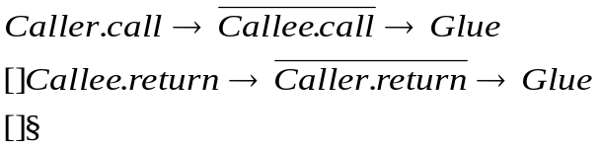
Wright Example
Component DataStore
Port getValues (behavior specification)
Port storeValues (behavior specification)
Computation (behavior specification)
Component Calculation
Port getValues (behavior specification)
Port storeValues (behavior specification)
Port calculate (behavior specification)
Computation (behavior specification)
Component UserInterface
Port getValues (behavior specification)
Port calculate (behavior specification)
Computation (behavior specification)
Connector Call
Role Caller =
Role Callee =
Glue =

Slide 11
Wright Example
Component DataStore
Port getValues (behavior specification)
Port storeValues (behavior specification)
Computation (behavior specification)
Component Calculation
Port getValues (behavior specification)
Port storeValues (behavior specification)
Port calculate (behavior specification)
Computation (behavior specification)
Component UserInterface
Port getValues (behavior specification)
Port calculate (behavior specification)
Computation (behavior specification)
Connector Call
Role Caller =
Role Callee =
Glue =
Configuration LunarLander
Instances
DS : DataStore
C : Calculation
UI : UserInterface
CtoUIgetValues, CtoUIstoreValues, UItoC, UItoDS : Call
Attachments
C.getValues as CtoUIgetValues.Caller
DS.getValues as CtoUIgetValues.Callee
C.storeValues as CtoUIstoreValues.Caller
DS.storeValues as CtoUIstoreValues.Callee
UI.calculate as UItoC.Caller
C.calulate as UItoC.Callee
UI.getValues as UItoDS.Caller
DS.getValues as UItoDS.Callee
End LunarLander.

Slide 12
Acme Example
//Global Types
Property Type returnsValueType = bool;
Connector Type CallType = {
Roles { callerRole; calleeRole; };
Property returnsValue : returnsValueType;
};
System LunarLander = {
//Components
Component DataStore = {
Ports { getValues; storeValues; }
};
Component Calculation = {
Ports { calculate; getValues; storeValues; }
};
Component UserInterface = {
Ports { getValues; calculate; }
};
// Connectors
Connector UserInterfaceToCalculation : CallType {
Roles { callerRole; calleeRole; };
Property returnsValue : returnsValueType = true;
}
Connector UserInterfaceToDataStore : CallType {
Roles { callerRole; calleeRole; };
Property returnsValue : returnsValueType = true;
}

Slide 13
Acme Example
Connector CalculationToDataStoreS : CallType {
Roles { callerRole; calleeRole; };
Property returnsValue : returnsValueType = false;
}
Connector CalculationToDataStoreG : CallType {
Roles { callerRole; calleeRole; };
Property returnsValue : returnsValueType = true;
}
Attachments {
UserInterface.getValues to
UserInterfaceToDataStore.callerRole;
UserInterfaceToDataStore.calleeRole to
DataStore.getValues;
UserInterface.getValues to
UserInterfaceToDataStore.callerRole;
UserInterfaceToDataStore.calleeRole to
DataStore.getValues;
UserInterface.calculate to
UserInterfaceToCalculation.callerRole;
UserInterfaceToCalculation.calleeRole to
Calculation.calculate;
Calculation.storeValues to
CalculationToDataStoreS.callerRole;
CalculationToDataStoreS.calleeRole to
DataStore.storeValues;
Calculation.getValues to
CalculationToDataStoreG.callerRole;
CalculationToDataStoreG.calleeRole to
DataStore.getValues;
};
}
//Global Types
Property Type returnsValueType = bool;
Connector Type CallType = {
Roles { callerRole; calleeRole; };
Property returnsValue : returnsValueType;
};
System LunarLander = {
//Components
Component DataStore = {
Ports { getValues; storeValues; }
};
Component Calculation = {
Ports { calculate; getValues; storeValues; }
};
Component UserInterface = {
Ports { getValues; calculate; }
};
// Connectors
Connector UserInterfaceToCalculation : CallType {
Roles { callerRole; calleeRole; };
Property returnsValue : returnsValueType = true;
}
Connector UserInterfaceToDataStore : CallType {
Roles { callerRole; calleeRole; };
Property returnsValue : returnsValueType = true;
}

Slide 14
For More Information
ACME: http://www.cs.cmu.edu/~acme
Rapide: http://pavg.stanford.edu/rapide/
Wright: http://www.cs.cmu.edu/afs/cs/project/able/www/wright/index.html
Aesop: http://www.cs.cmu.edu/afs/cs/project/able/www/aesop/aesop_home.html
Unicon: http://www.cs.cmu.edu/afs/cs/project/vit/www/unicon/index.html
C2 SADL: http://www.ics.uci.edu/pub/arch/
SSEP: http://www.mcc.com/projects/ssepp
ADML: http://www.mcc.com/projects/ssepp/adml

Slide 15
UML – the Unified Modeling Language
The most popular ADL in practice together with “4+1”
Advantages
  Support for a diverse array of viewpoints focused on many common software engineering concerns
  Ubiquity improves comprehensibility
  Extensive documentation and tool support from many vendors
Disadvantages
  Needs customization through profiles to reduce ambiguity

Slide 16
Main Contents
Modeling and Documenting Software Architecture
“Architectural Blueprints — The “4+1” View Model of Software Architecture”
UML描述示例

Slide 17
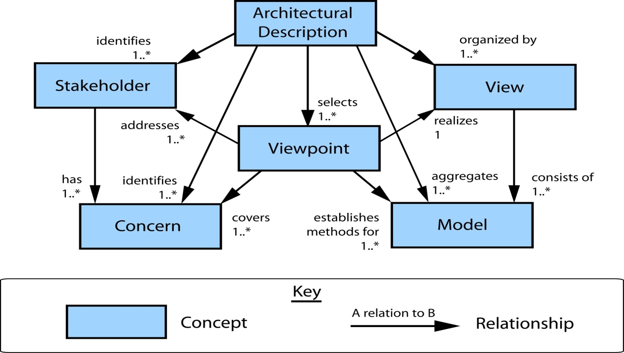
Multi-Viewpoint Model of IEEE
Adapted from “IEEE Recommended Practice for Architectural Description of Software Intensive Systems”. IEEE (2000)

Slide 18

Multi-Viewpoint Model of IEEE
——IEEE 1471 Core Concepts
stakeholder
  An individual, team, or organization (or classes thereof) with interests in, or concerns relative to, a system
Concerns
  Interests which pertain to the system’s development, its operation or any other aspects that are critical or otherwise important to one or more stakeholders
View
  A representation of a whole system from the perspective of a related set of concerns
Viewpoint
  A specification of the conventions for constructing and using a view
  A pattern or template from which to develop individual views by establishing the purposes and audience for a view and the techniques for its creation and analysis
Architecture (informational)
  the fundamental organization of a system, embodied in its components, their relationships to each other and the environment, and the principles governing its design and evolution

Slide 19

About Kruchten
Philippe Kruchten
  Over 16 years of experience as the leader of RUP development team in Rational corp. (now owned by IBM)
  Valuable experiences in industry (Telecom, Air traffic control system) which he used them for confirmation of his model

Slide 20


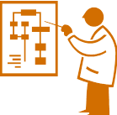

4+1 View Model of Architecture
End user
Logical view
Development
view
Programmers
& software
managers
Scenarios
Process View
Physical View
Integrator
System Engineer
Notes:
The architecture in fact partially evolved from these scenarios as well as
The model is rather generic, and other notations and tools can be used, other design methods can be used especially for the logical and process decompositions
For each view, the architects can pick a certain architectural style
Similar views in UML
Use case view> - Encompass the use cases that describe the behavior of the system as seen by its end users, analysts, and testers
Design view - Encompass the classes, interfaces, and collaborations that form the vocabulary of the problem and its solution
Process view - Encompass the threads and processes that form the system's concurrency and synchronization mechanisms
Implementation view - Encompass the components and files that are used to assemble and release the physical system
Deployment view - Encompass the nodes that form the system's hardware topology on which the system executes

Slide 21
Logical View
(Object-oriented Decomposition)
The system is decomposed into a set of key abstractions, taken (mostly) from the problem domain, in the form of objects or object classes
  {Component, connector, configuration} better
Viewer: End-user
considers: Functional requirements- What the system should provide in terms of services to its users.
This decomposition is not only for the sake of functional analysis, but also serves to identify common mechanisms and design elements across the various parts of the system

Slide 22
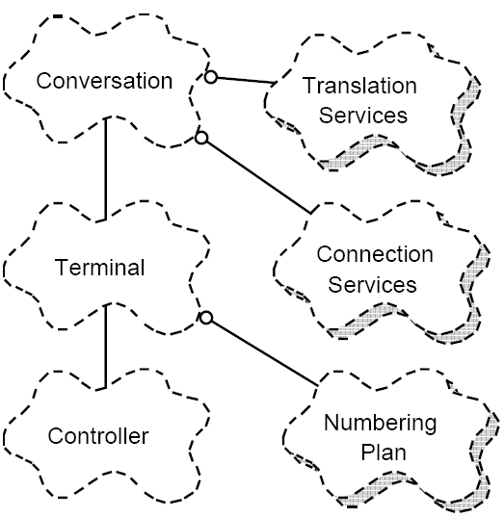
Logical view Example

Slide 23
逻辑视图
部件类型可以用以构造型《component》扩展了的类来描述
  可以拥有端口
连接件类型可以用以构造型《 connector 》扩展了的类来描述
  用类的端口来描述角色
用构造型《Property》扩展属性来描述特征
  《component》类中的《Property》属性用来描述部件的特征
  《connector》类中的《Property》属性用来描述连接件的特征

Slide 24
逻辑视图
用对象图描述配置
为部件类型建立行为状态图，描述部件类型的详细功能规格；
为连接件类型建立行为状态图，描述连接件类型的交互机制；
为端口/角色建立协议状态机，描述部件端口和连接件角色的交互协议；
为配置和复合类型建立顺序图，描述配置和复合类型所包含的功能规格。

Slide 25
Development View
(Subsystem decomposition)
Basis of a line of product
The development architecture of the system is represented by module and subsystem diagrams, showing the ‘export’ and ‘import’ relationships.
Viewer: Programmers and Software Managers
considers: software module organization
(Hierarchy of layers, software management, reuse, constraints of tools)
Style: layered style

Slide 26
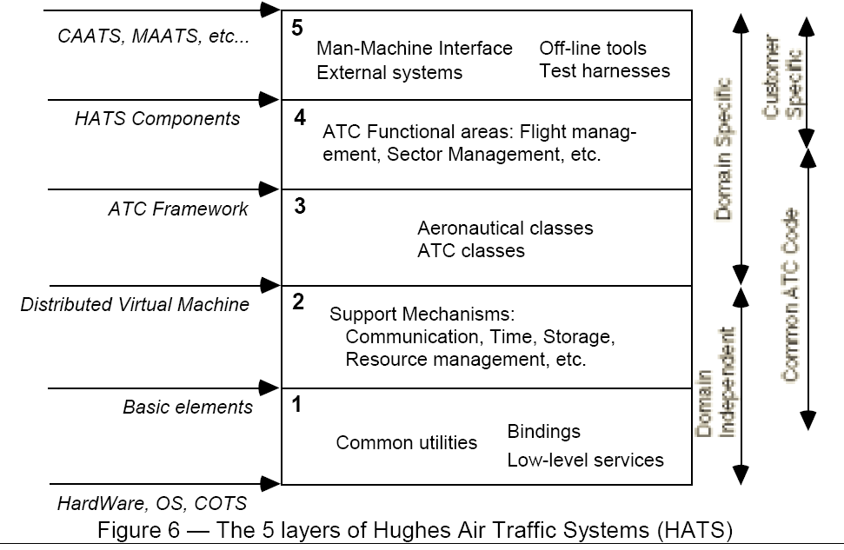
Development View Example

Slide 27
开发视图
UML的构件图（Component Diagram）可以用来描述软件体系结构实现模块的组织；
以UML提供的构造型《subsystem》，可以描述实现模块的子系统组织和分层组织

Slide 28
Process View
(The process decomposition)
viewer: Integrators
considers: Non - functional requirements (concurrency, performance, scalability)
style: Several styles would fit in this view (Garlan and Shaw ‘s Architecture styles)

Slide 29
Process view (cont.)
Uses multiple levels of abstractions, a logical network of processes at the highest level
A process is a grouping of tasks that form an executable unit:
The software is partitioned into a set of independent tasks
  Major Tasks: Arch. relevant tasks
  Minor Tasks: Helper tasks. (Buffering)

Slide 30
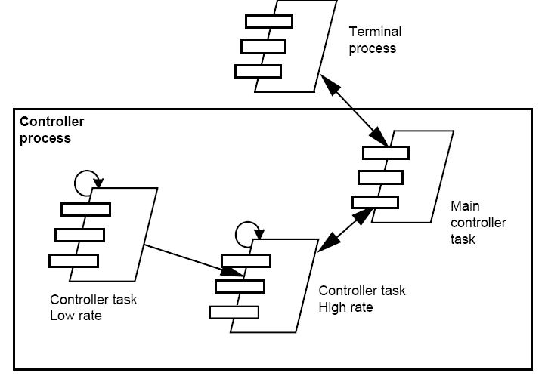
Process View example

Slide 31
进程视图
UML定义的主动类（Active Class）可以用来描述进程
利用UML的顺序图，可以更详细地描述进程之间的通信机制
给出 逻辑视图/开发视图 与进程视图的映射表

Slide 32
Physical View
(Mapping the software to the Hardware)
Topology, Communication)
  The various elements identified— networks, processes, tasks, and objects—need to be mapped onto the various nodes.
    We expect that several different physical configurations will be used
Viewer: System Engineers
Considers: Non-functional req. regarding to underlying hardware (availability, reliability (fault-tolerance), performance (throughput), and scalability)

Slide 33
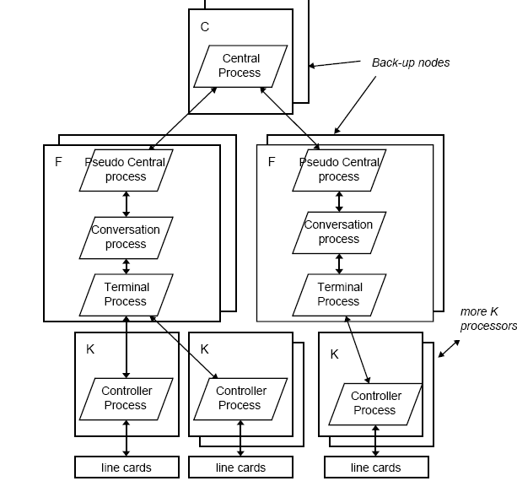
Physical view example (cont.)

Slide 34
部署视图
用UML部署视图描述
  体现进程的部署
  体现开发构件的部署

Slide 35
Scenarios
(Putting it all together)
The elements in the four views are shown to work together seamlessly by the use of a small set of important scenarios
Viewer: All users of other views and Evaluators.
Considers: System consistency, validity
Help Architect during the architecture design
Help illustrate and validate the document

Slide 36
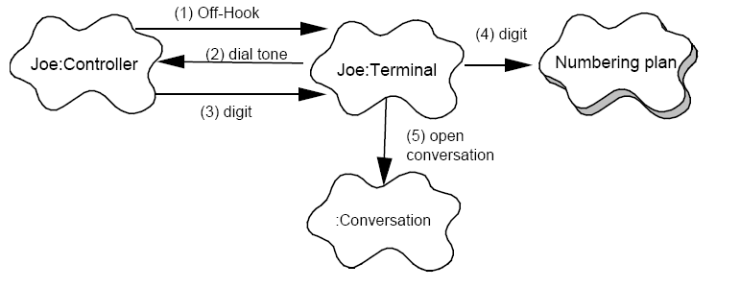
Scenario example
The controller of Joe’s phone detects and validate the transition from on-hook to off-hook and sends a message to wake up the corresponding terminal object.
The terminal allocates some resources, and tells the controller to emit some dial-tone.
The controller receives digits and transmits them to the terminal.
The terminal uses the numbering plan to analyze the digit flow.
When a valid sequence of digits has been entered, the terminal opens a conversation

Slide 37
Correspondence between views
Views are interconnected.
Start with Logical view (Req. Doc) and Move to Development or Process view and then finally go to Physical view.

Slide 38
4+1 View Model of Architecture
End user
Logical view
Development
view
Programmers
& software
managers
Scenarios
Process View
Physical View
Integrator
System Engineer
Notes:
The architecture in fact partially evolved from these scenarios as well as
The model is rather generic, and other notations and tools can be used, other design methods can be used especially for the logical and process decompositions
For each view, the architects can pick a certain architectural style
Similar views in UML
Use case view> - Encompass the use cases that describe the behavior of the system as seen by its end users, analysts, and testers
Design view - Encompass the classes, interfaces, and collaborations that form the vocabulary of the problem and its solution
Process view - Encompass the threads and processes that form the system's concurrency and synchronization mechanisms
Implementation view - Encompass the components and files that are used to assemble and release the physical system
Deployment view - Encompass the nodes that form the system's hardware topology on which the system executes

Slide 39
From Logical to development
They are very close, but the larger the project, the greater the distance
A class (Component) is usually implemented as a module, Large classes(Component) are decomposed into multiple packages
Package design principles needed!
Grouping to subsystems based on:
  team organization, expected magnitude of code (typically 5K to 20K SLOC per subsystem), degree of expected reuse and commonality, and strict layering principles (visibility issues), release policy and configuration management.

Slide 40
From logical to Process view
Two strategy to analyse level of concurrency:
  Inside-out: starting from Logical structure
    define agent tasks
    Objects executed on that same agent;
    several classes that need to be executed in mutual exclusion
  Outside-in: starting from physical structure
    identify external stimuli (requests) to the system,
    define client and servers processes;
    define the right set of servers, and allocate objects to the client and servers agents;

Slide 41
From development/process to physical
Packages( Processes) are mapped onto the available physical hardware, in various configurations for testing or deployment

Slide 42
The Iterative process
Not all software arch. Need all views.
A scenario-driven approach to develop the system
Documentation:
  Software architecture document
  Software design guidelines

Slide 43
Remarks
Methodology successfully used in the industry
  Air Traffic Control
  Telecom
Comprehensive: All other views are reducible to one of the 4 views

Slide 44
Main Contents
Modeling and Documenting Software Architecture
“Architectural Blueprints — The “4+1” View Model of Software Architecture”
UML描述示例

Slide 45
有一个软件开发企业想在其局域网内建立一个资源管理系统，现状如下：
  公司每天都要做大量的代码处理工作：简单的语言互转（例如将Java转换为C++，或者反之），各种语言程序的自动集成与测试，对不同语言进行切片等程序分析，进行编码的转换（Unicode转换为GBK）……
  为了更好地完成上述工作，该公司购买了很多工具软件。但是因为工具软件的注册数量限制，而且一台机器也无法提供足够的资源同时支持很多工具软件，所以各工具软件被分散地安装在整个局域网内，形成了可以利用的分散资源。这种分散使得各种资源的寻找和利用都面临着很大的问题，效率低下

Slide 46
为了解决工具软件在局域网内比较分散以致不利于充分利用的问题，该公司计划开发一个资源管理系统：
  在局域网的每一个机器上都安装客户端：
    用户可以通过客户端向服务器申请获得特定类型的资源；
    用户可以通过客户端向资源的管理机器请求使用获得的资源。
  局域网内有多台服务器：
    服务器维护资源的分布及使用情况；
    服务器可以为提出申请的用户分配相应的资源；
    为了防止服务器故障导致系统崩溃，提高系统的可靠性，需要使用多台并发服务器；

Slide 47
为了解决工具软件在局域网内比较分散以致不利于充分利用的问题，该公司计划开发一个资源管理系统：
  安装有工具软件资源的机器需要进行本地资源的管理：
    系统要定期复查拥有资源机器的加入与退出情况；
    定期向服务器通报最新的资源使用及空闲情况；
    提供统一的资源管理接口，方便客户端对资源的远程使用；
    要易于接受新的资源类型，具有好的可扩展性。

Slide 48
用例视图
包括来自于SRS的概要功能需求
强调来自于SRS中的质量需求
  质量需求用例与场景
也包括不在SRS中的项目环境
  项目环境用例与场景

Slide 49
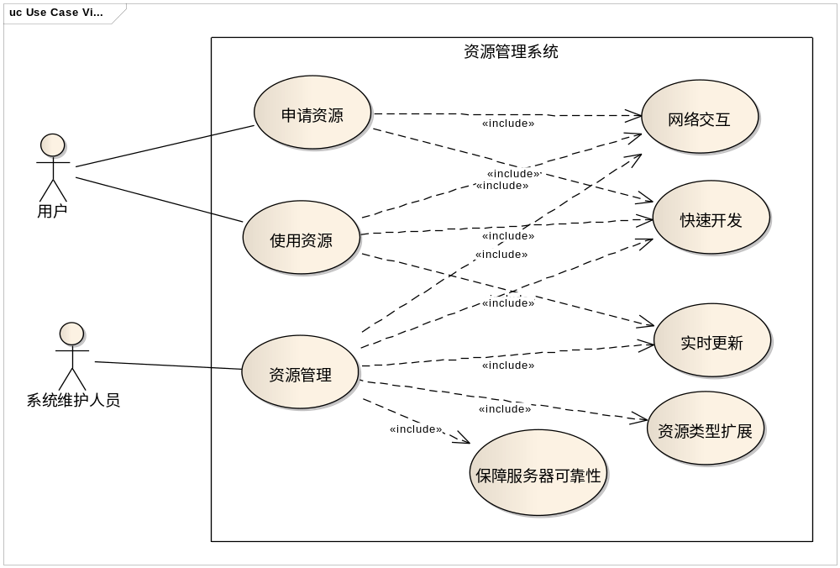
用例视图

Slide 50
逻辑视图
部件类型可以用以构造型《component》扩展了的类来描述
  可以拥有端口
连接件类型可以用以构造型《 connector 》扩展了的类来描述
  用类的端口来描述角色
用构造型《Property》扩展属性来描述特征
  《component》类中的《Property》属性用来描述部件的特征
  《connector》类中的《Property》属性用来描述连接件的特征

Slide 51
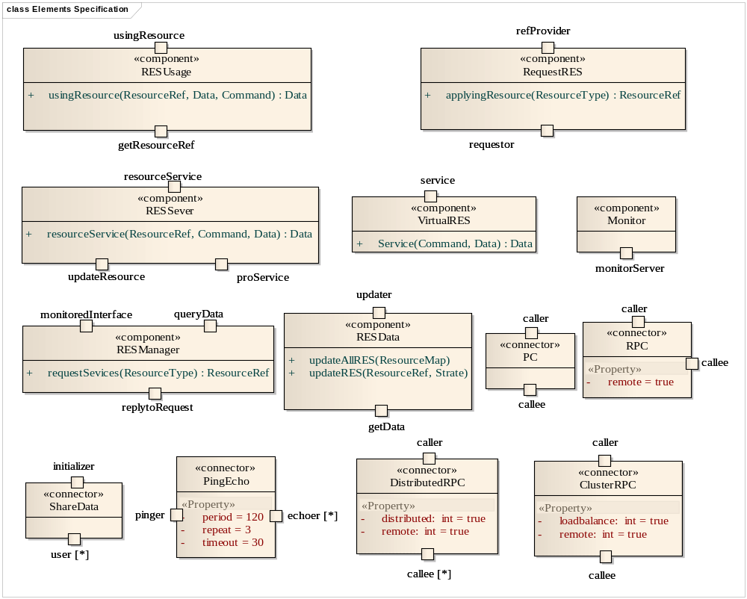

Slide 52
逻辑视图
用对象图描述配置
为部件类型建立行为状态图，描述部件类型的详细功能规格；
为连接件类型建立行为状态图，描述连接件类型的交互机制；
为端口/角色建立协议状态机，描述部件端口和连接件角色的交互协议；
为配置和复合类型建立顺序图，描述配置和复合类型所包含的功能规格。

Slide 53
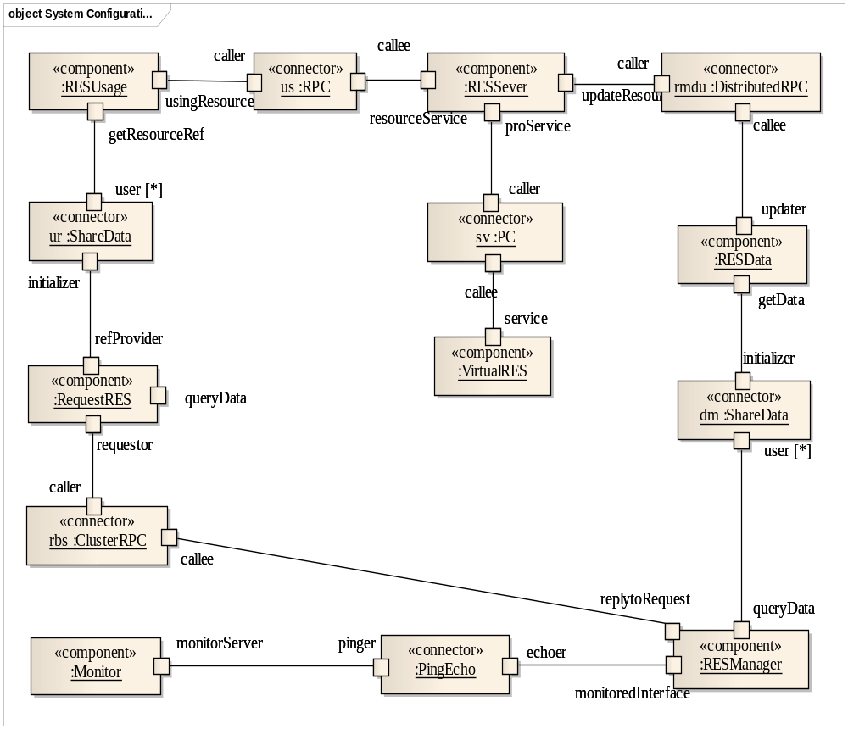

Slide 54
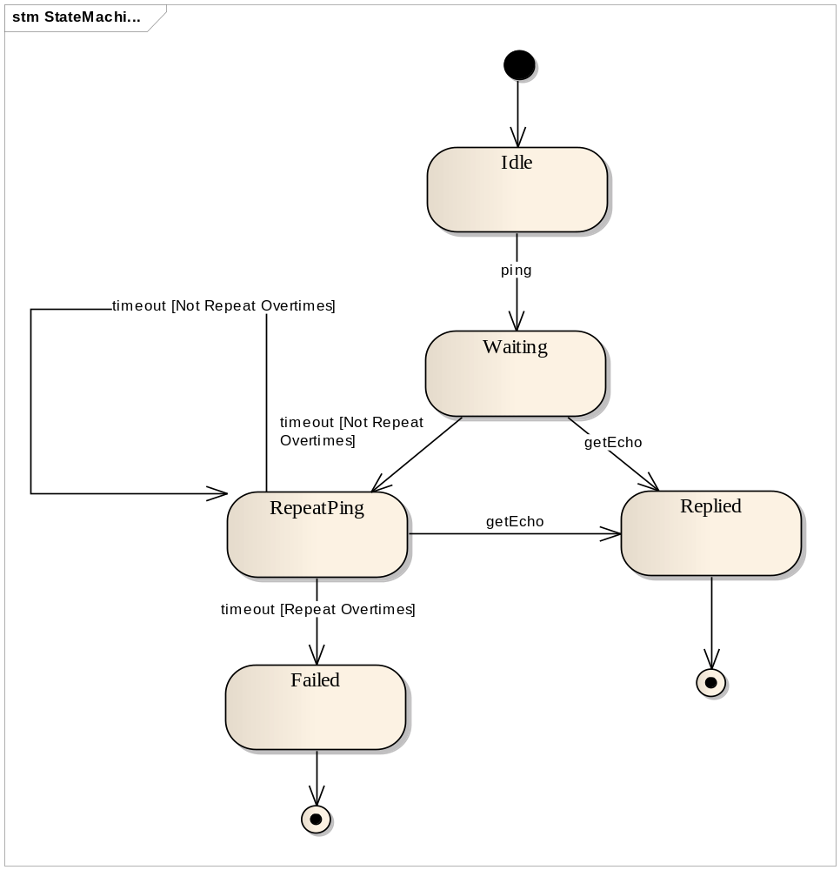
Ping/
Echo

Slide 55
开发视图
UML的构件图（Component Diagram）可以用来描述软件体系结构实现模块的组织；
以UML提供的构造型《subsystem》，可以描述实现模块的子系统组织和分层组织

Slide 56
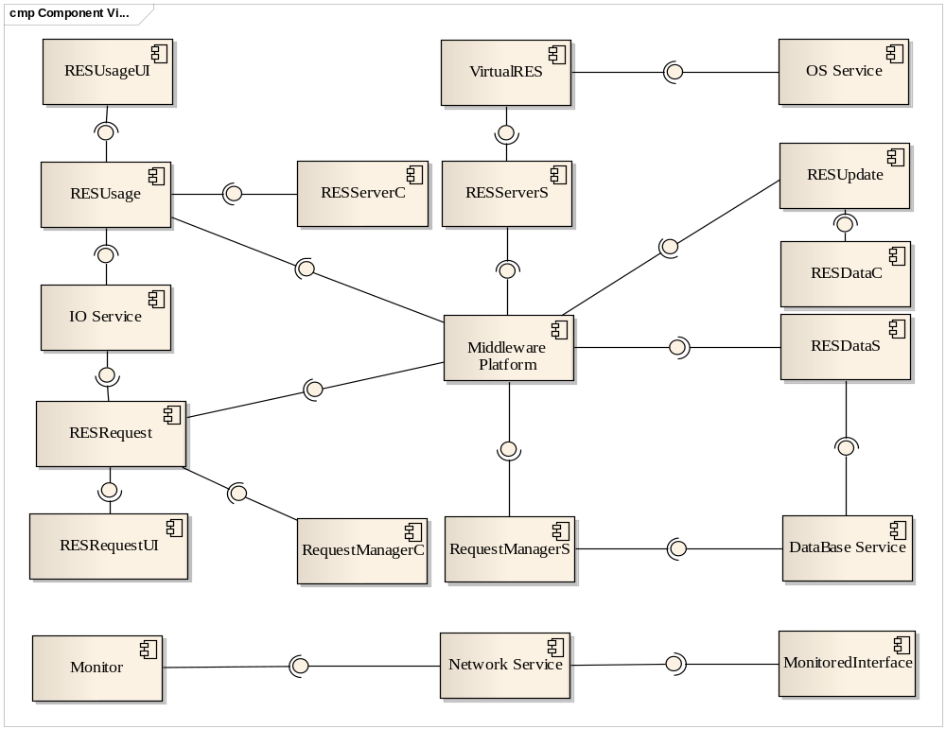

Slide 57
逻辑视图与开发视图的映射关系描述
部件/连接件 | 实现模块/构件
RESUsage | RESUsageUI, RESUsage
RequestRES | RESRequestUI, RESRequest
RESServer | RESServerC, RESServerS, RESUpdate, OS Service
RESManager | RequestManagerC, RequestManagerS
RESData | RESDataC, RESDataS
Monitor | Monitor, Mornitored Interface
RPC,DRPC,CRPC | Middleware Platform
PingEcho | Network Service,
ShareData | IO Service, DataBase Service

Slide 58
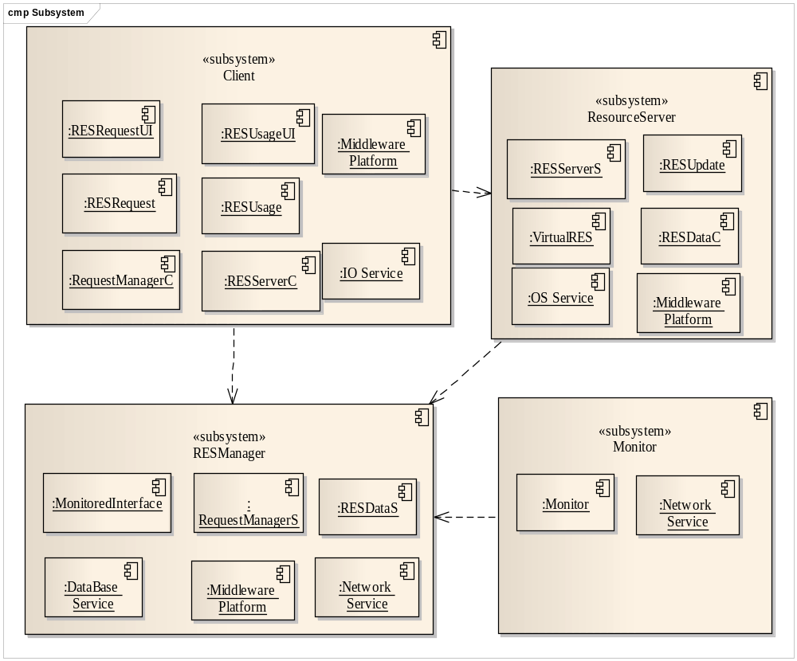

Slide 59
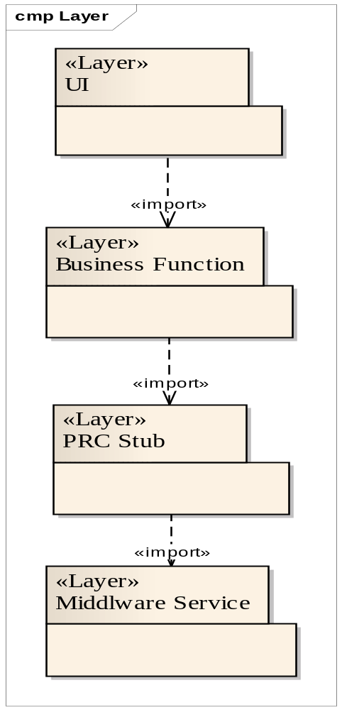

Slide 60
进程视图
UML定义的主动类（Active Class）可以用来描述进程
利用UML的顺序图，可以更详细地描述进程之间的通信机制
给出 逻辑视图/开发视图 与进程视图的映射表

Slide 61
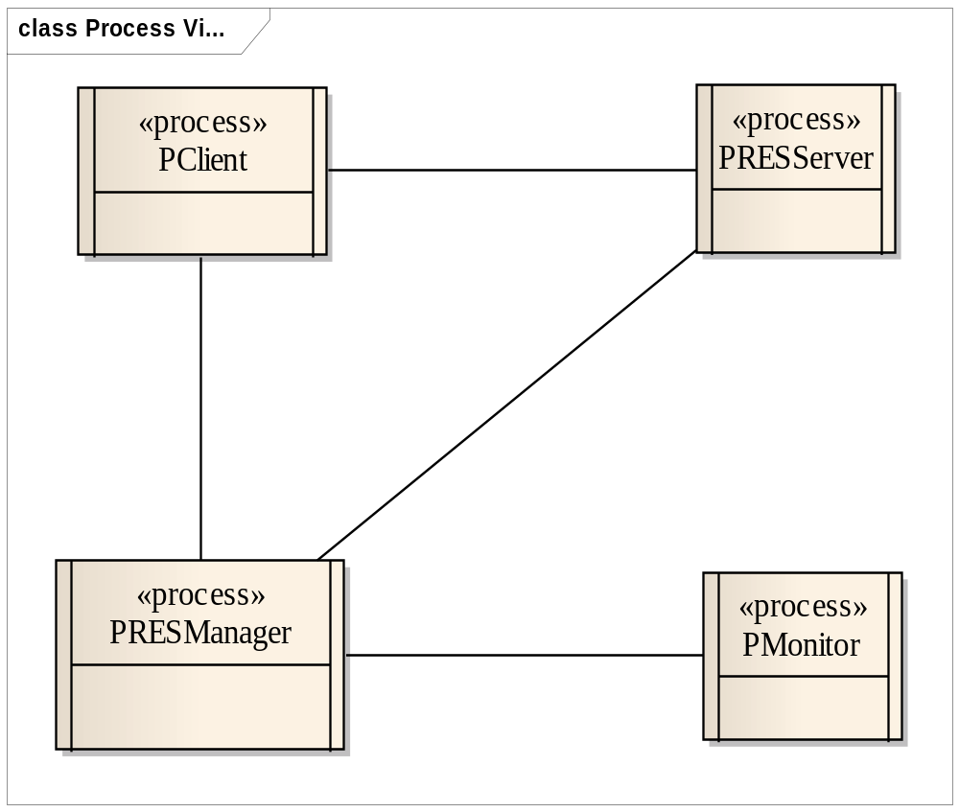

Slide 62
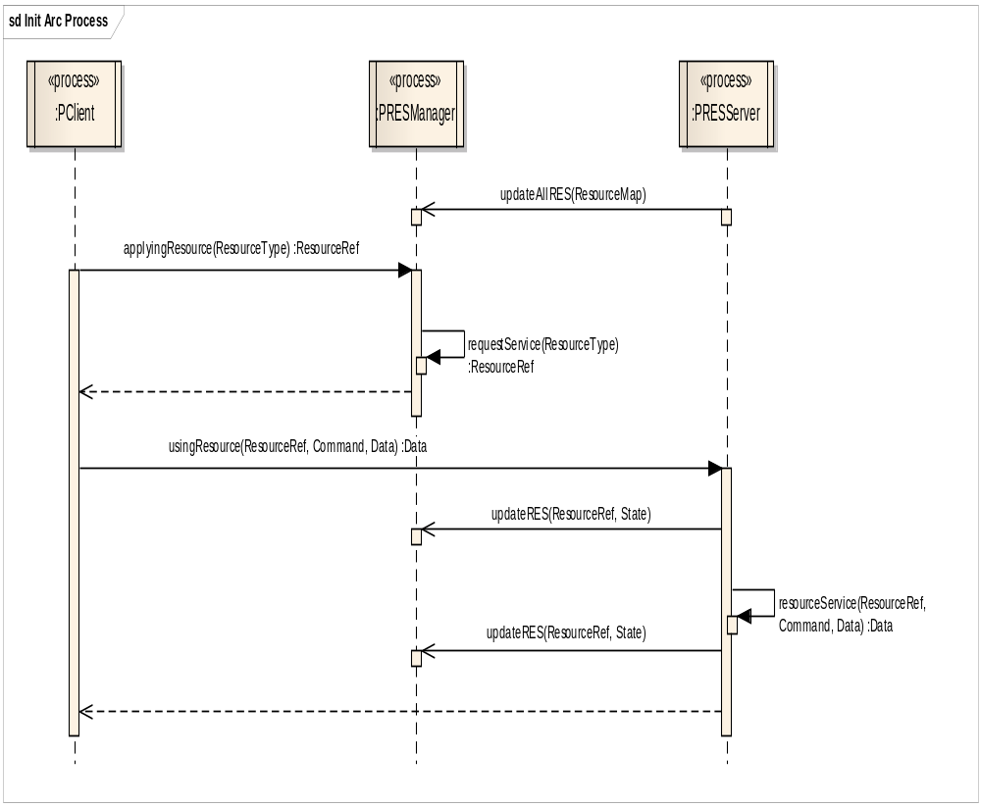

Slide 63
部署视图
用UML部署视图描述
  体现进程的部署
  体现开发构件的部署

Slide 64
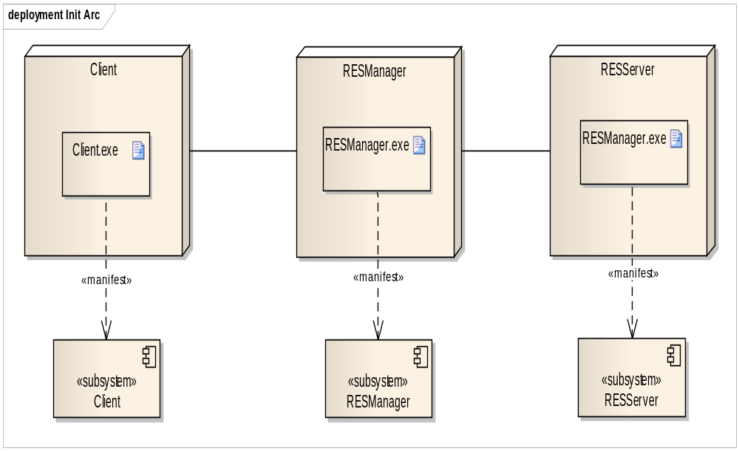

Slide 65
?

